Slide 1
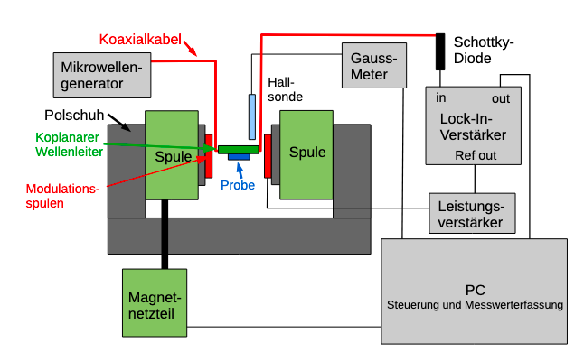
Coaxial cable
Schottky diode
Gauss Meter
VNA
In
Out
Pole piece
Lock-in Amplifier
Coplanar waveguide (CPW)
Solenoid
Solenoid
Solenoid
Ref out
Modulation coil
Sample
Series Resistance
Power Supply
PC
Control and Measurement

Slide 2
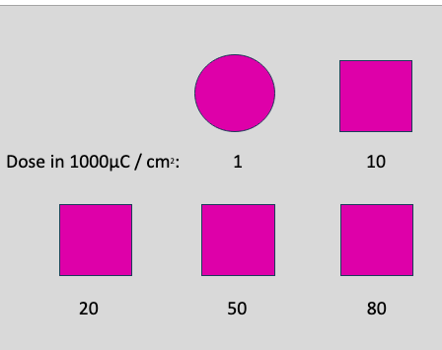
Dose in 100 µC/cm² :

Slide 3
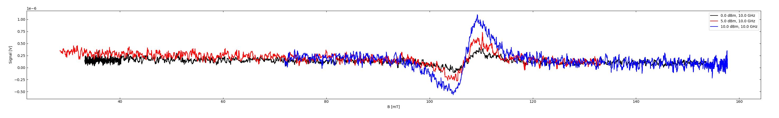

Slide 5
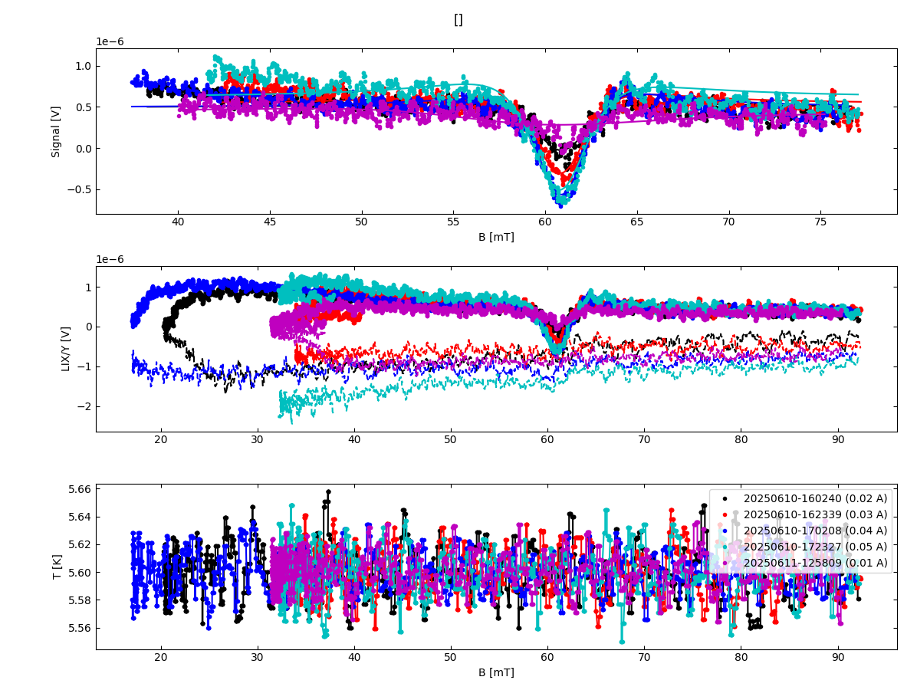

Slide 6
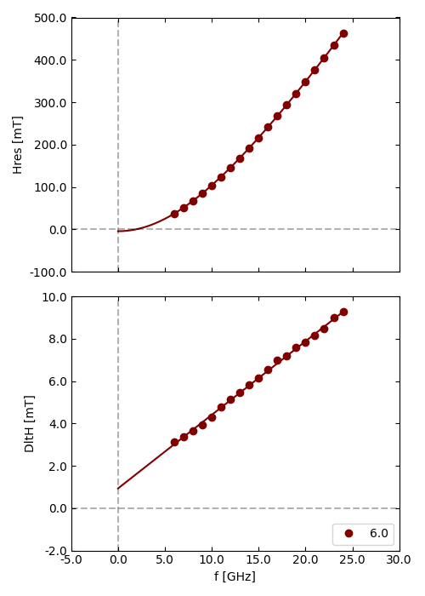

Slide 7
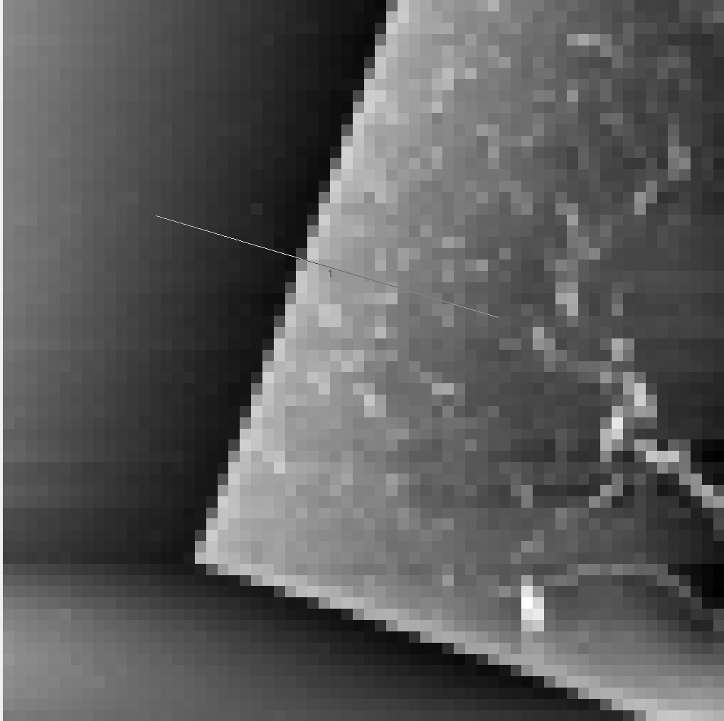
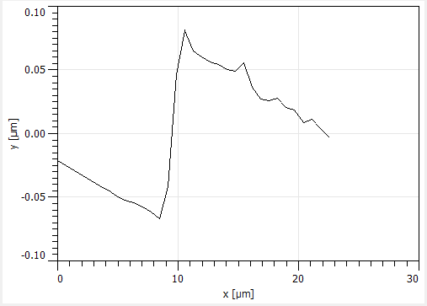
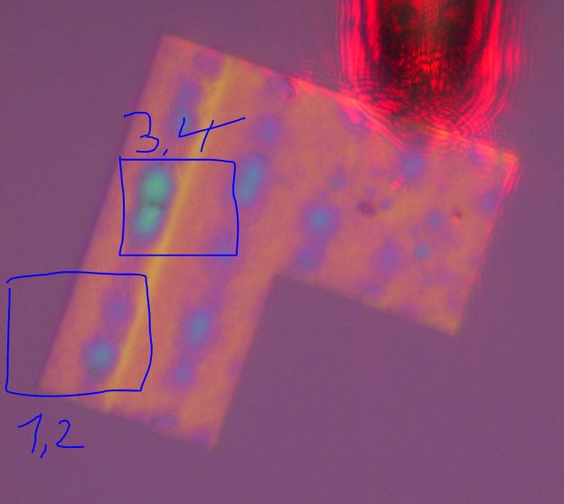
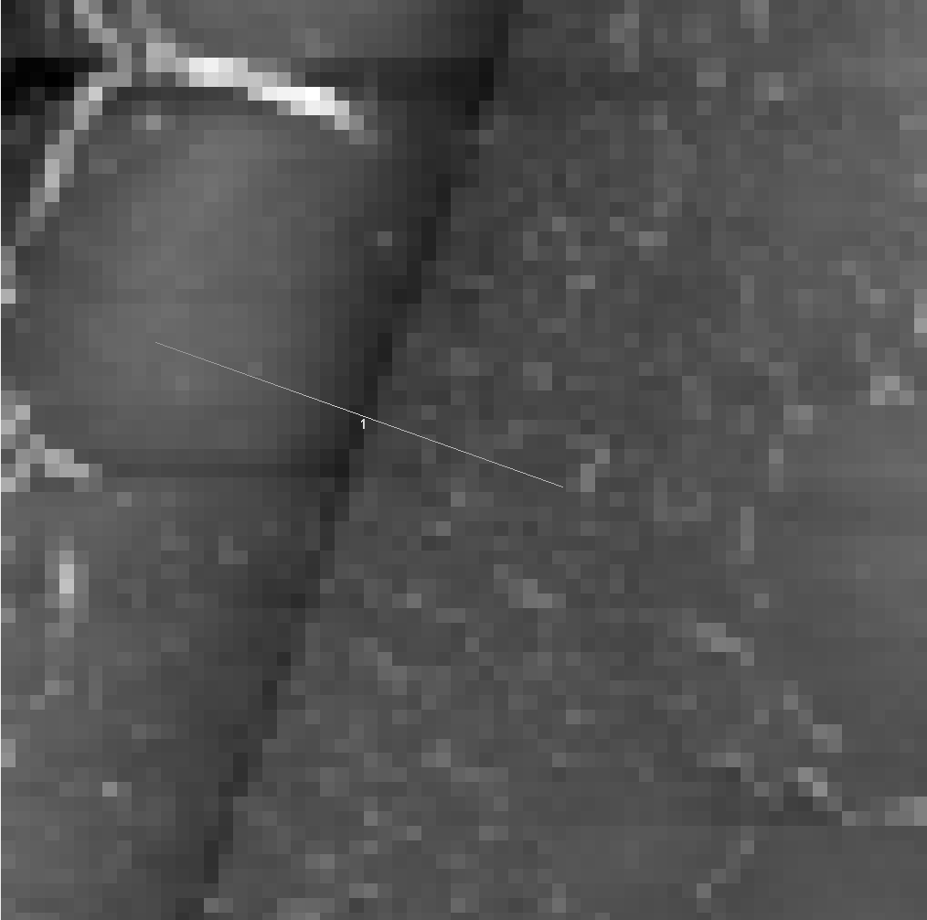
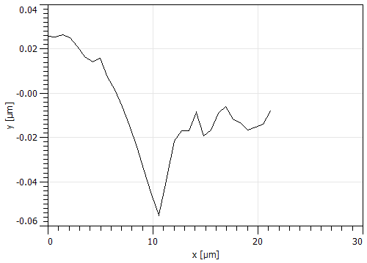
2a)
2b)
1)
3a)
3b)

